Slide 1
How Does Regularization Influence The Performance Of Network With Projection Shortcuts
Lizhen Zhu (Presenter), Yuxuan Duan
Team #5
Shanghai Jiao Tong University
{zhulz98, sjtudyx2016}@sjtu.edu.cn

Slide 2
1
Review
2
L1-norm, L2-norm
3
Relations between Parameters
4
Conclusions and Further Work

Slide 3
1
Review
2
L1-norm, L2-norm
3
Relations between Parameters
4
Conclusions and Further Work

Slide 4
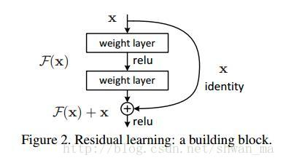
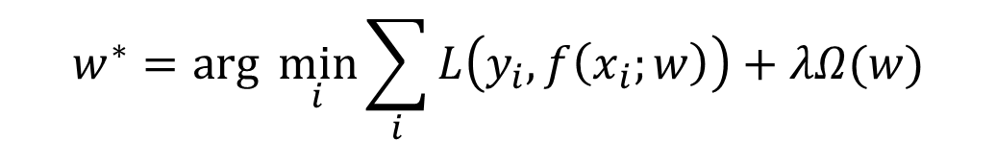
Review
Regularization: Knowledge already known
Better result
$$w^{∗}=arg \min_{i}{\sum_{i}{L\left(y_{i},f\left(x_{i};w\right)\right)+λΩ(w)}}$$
Loss Function:
projection shortcut:
X · W

Slide 5
1
Review
2
L1-norm, L2-norm
3
Relations between Parameters
4
Conclusions and Further Work

Slide 6
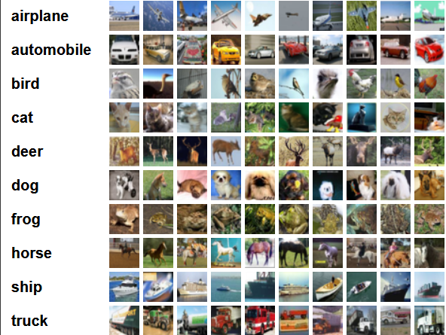
32*32*3 image
CIFAR-10 dataset
3*3 conv, 9
3*3 conv, 27
3*3 conv, 27
3*3 conv, 81
3*3 conv, 243
3*3 conv, 243
pooling, flatten
FC, 2592
FC, 432
FC, 432
FC, 72
FC, 24
FC, 24
FC, 10

Slide 7
epoch

Slide 8

add L1-norm: $w^{∗}=arg \min_{i}{\sum_{i}{L\left(y_{i},f\left(x_{i};w\right)\right)+λ}}\sum_{w}{\left|w\right|}$
Update in terms of the whole matrices
Radical
$$λ$$

Slide 9
add L2-norm: $w^{∗}=arg \min_{i}{\sum_{i}{L\left(y_{i},f\left(x_{i};w\right)\right)+λ}}\sum_{w}{w^{2}}$
Change the parameters proportionally
Soft
$$λ$$

Slide 10
1
Review
2
L1-norm, L2-norm
3
Relations between Parameters
4
Conclusions and Further Work

Slide 11
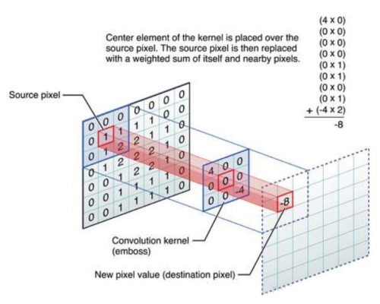
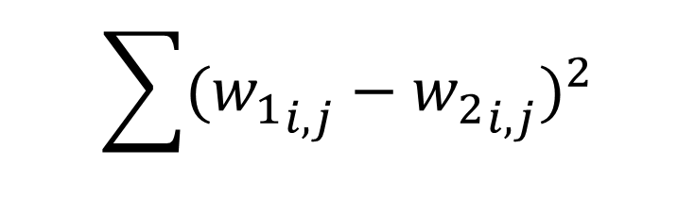
Similarity of Filters
$$\sum{{({w_{1}}_{i,j}−{w_{2}}_{i,j})}^{2}}$$

Slide 12




Similarity of Matrices
$$w_{s}$$
$$w_{1}^{T}⋅w_{s}$$
v
v
v
v
v
v
$$w_{1}$$
$$w_{2}$$

Slide 13

add fully connected block orthogonal regualrization
$$λ$$

Slide 14
1
Review
2
L1-norm, L2-norm
3
Relations between Parameters
4
Conclusions and Further Work

Slide 15
Conclusion:
Further Work:
L1-norm, L2-norm: good to prevent overfitting
Similarity of FC layers: good to improve results in some values
Similarity of Conv layers:
????
Finish research on convolutional layers
more times and more value of lambda on each data
new reasonable function to evaluate the similarity
try other relationships between the parameters

Slide 16
Thank you Q&A

